Slide 1
Introduction to Computational Thermodynamics
Section 3.2
Pure Saturation Envelopes

Slide 2
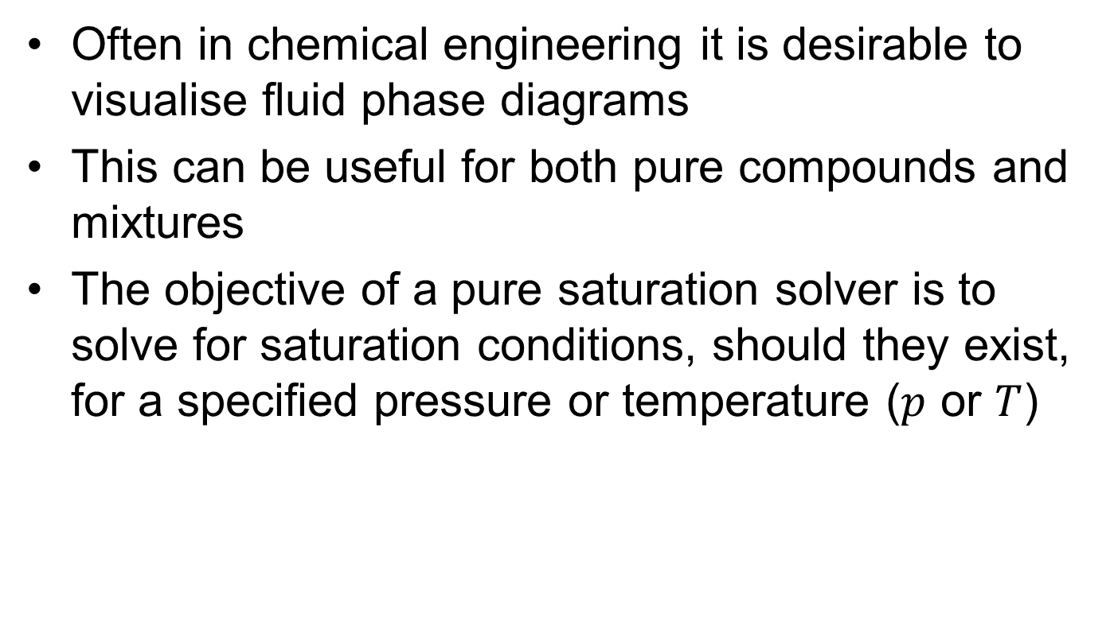
Introduction
Often in chemical engineering it is desirable to visualise fluid phase diagrams
This can be useful for both pure compounds and mixtures
The objective of a pure saturation solver is to solve for saturation conditions, should they exist, for a specified pressure or temperature ($p$ or $T$)

Slide 3
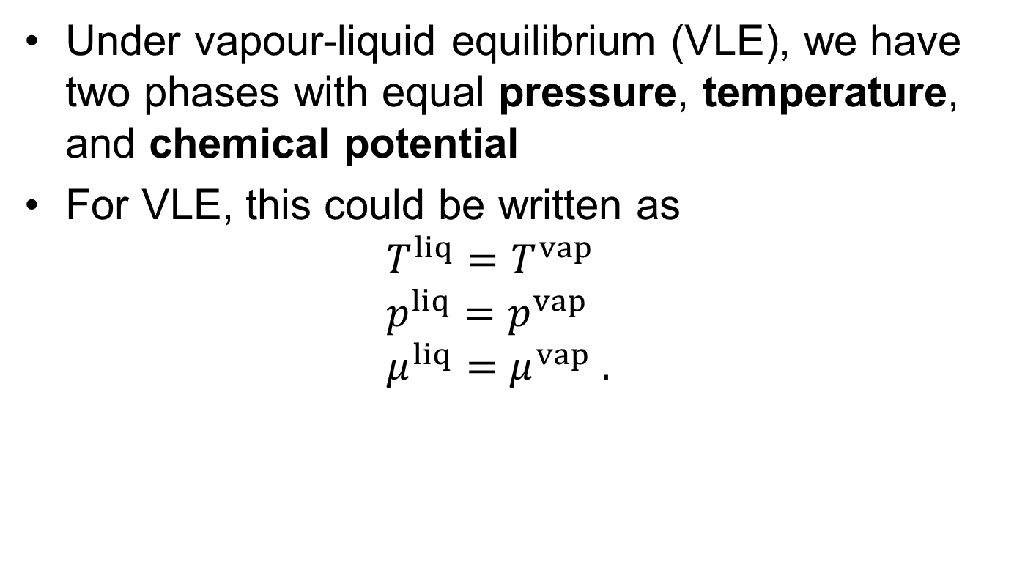
Specification of Equilibrium
Under vapour-liquid equilibrium (VLE), we have two phases with equal pressure, temperature, and chemical potential
For VLE, this could be written as $T^{liq}=T^{vap}$ $p^{liq}=p^{vap}$ $μ^{liq}=μ^{vap} .$

Slide 4

Variable selection
To solve for each phase, we need a variable that is different for vapour and liquid. We choose to iterate using the volume
Typically, we specify either temperature ($T$) or pressure ($p$).
Notes:
Draw a picture of a saturation curve and show the solver converging from either side using the volume

Slide 5
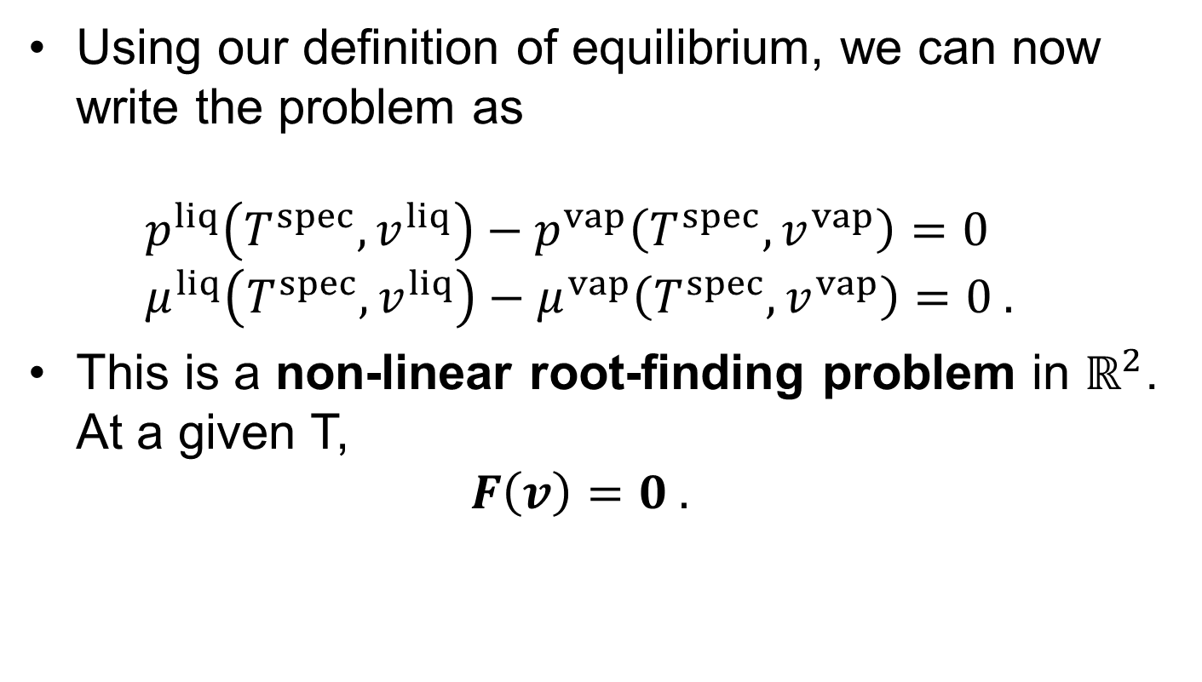
Problem Specification - Pressure
Using our definition of equilibrium, we can now write the problem as $p^{liq}\left(T^{spec}, v^{liq}\right)−p^{vap}\left(T^{spec}, v^{vap}\right)=0$ $μ^{liq}\left(T^{spec}, v^{liq}\right)−μ^{vap}\left(T^{spec}, v^{vap}\right)=0 .$
This is a non-linear root-finding problem in $ℝ^{2}$. At a given T, $F\left(v\right)=0 .$

Slide 6
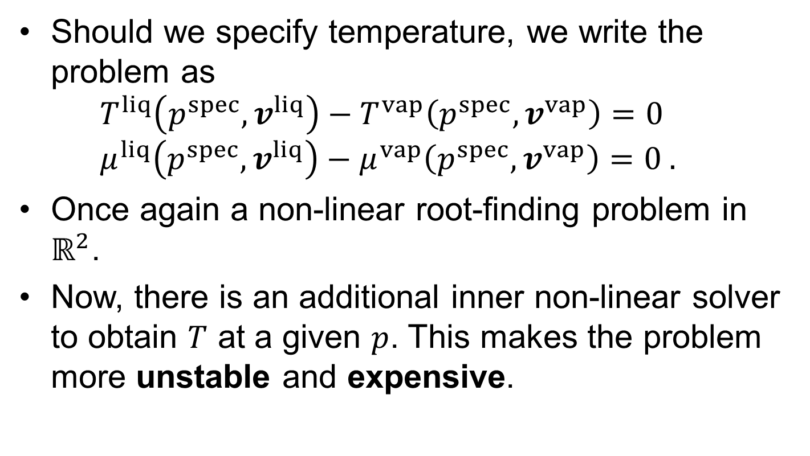
Problem Specification - Temperature
Should we specify temperature, we write the problem as $T^{liq}\left(p^{spec}, v^{liq}\right)−T^{vap}\left(p^{spec}, v^{vap}\right)=0$ $μ^{liq}\left(p^{spec}, v^{liq}\right)−μ^{vap}\left(p^{spec}, v^{vap}\right)=0 .$
Once again a non-linear root-finding problem in $ℝ^{2}$.
Now, there is an additional inner non-linear solver to obtain $T$ at a given $p$. This makes the problem more unstable and expensive.

Slide 7
Initial Guesses
As with volume solvers, initial guesses are very important for converging successfully
We cannot use the same method as we did for our volume solver (ideal gas + packing fraction) – we have only specified one variable!

Slide 8
Initial Guesses
As with volume solvers, initial guesses are very important for converging successfully
We cannot use the same method as we did for our volume solver (ideal gas + packing fraction) – we have only specified one variable!
The solution – the van der Waals (vdW) equation of state (EoS)!

Slide 9
Solution to vdW EoS
From the van der Waals equation of state we can obtain an expression for the saturation curve in terms of the reduced temperature and pressure
This relates to the theory of corresponding states
We can exploit this to use as our initial guess

Slide 10
Solution to vdW EoS
From the van der Waals equation of state we can obtain an expression for the saturation curve in terms of the reduced temperature and pressure
This relates to the theory of corresponding states
We can exploit this to use as our initial guess
We use a fitted approximation to the numerical solution

Slide 11
Solution to vdW EoS
Saturation envelope for vdW in reduced variables
Compare to other EoS for specific compounds

Slide 12
Implementation
To solve this, we use Newton’s method and derivatives provided by automatic differentiation
Switch to notebook and show live implementation
Notes:
Jfx = Jf(logV) # Calculate the jacobian
fx = f(logV) # Calculate the value of f at V
d = -Jfx\fx # Calculate the newton step
logVold = logV # Store current iteration
logV = logV .+ d # Take newton step
iters += 1 # Increment our iteration counter

Slide 13
Building phase diagrams
This is much the same as the saturation pressure solver, however:
Initial guesses become very challenging as we approach the critical point
To avoid this, we reuse previous solutions as initial guesses for the next point
This approach is relevant beyond this application – many times we will have a previous iteration or solution that can act as a starting point for our algorithms

Slide 14
Critical point solver
For cubic EoS, the critical point is an input, so we always know this

Slide 15
Critical point solver
For cubic EoS, the critical point is an input, so we always know this
How do we know the critical point for SAFT / other EoS? We need to solve for it!
A “standard” way of doing this would be to march our saturation solver upwards until it fails, then interpolate between the vapour and liquid saturation curves
Notes:
Anecdote about Andrew describing to me how they used to manually locate the critical point by interpolating by hand between the vapour and liquid phases

Slide 16
Critical point solver
For cubic EoS, the critical point is an input, so we always know this
How do we know the critical point for SAFT / other EoS? We need to solve for it!
Notes:
Anecdote about Andrew describing to me how they used to manually locate the critical point by interpolating by hand between the vapour and liquid phases

Slide 17
Critical point solver
For cubic EoS, the critical point is an input, so we always know this
How do we know the critical point for SAFT / other EoS? We need to solve for it!
A “standard” way of doing this would be to march our saturation solver upwards until it fails, then interpolate between the vapour and liquid saturation curves
However, thanks to autodiff, we can solve for this directly!

Slide 18

Critical point solver
When considering the projection into $p, v$ space, the critical point of a pure fluid can be defined as the point of inflection along a unique isotherm
We can write three equations describing this point exactly

Slide 19
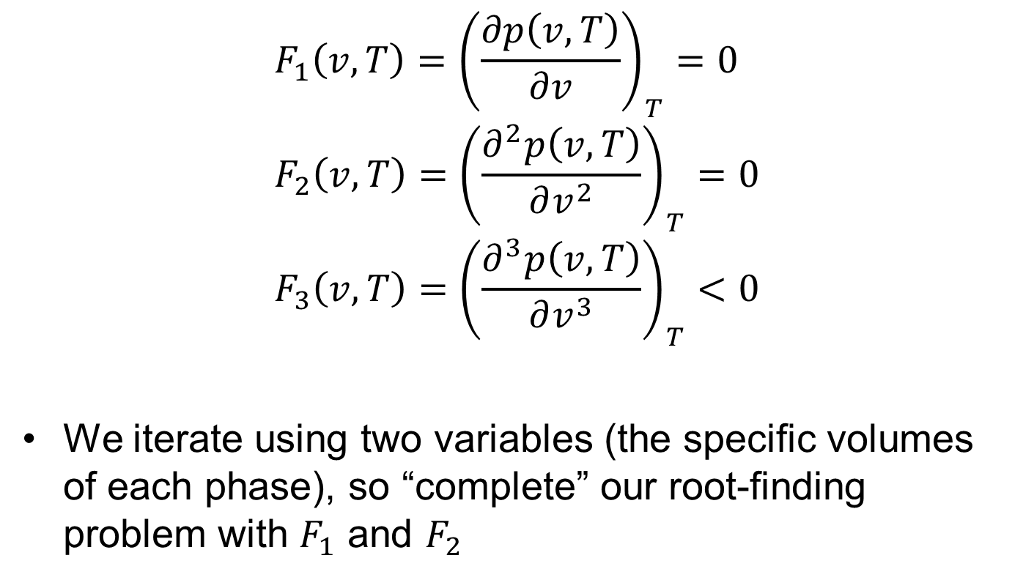
Critical point solver
$$F_{1}\left(v, T\right)={\left(\frac{∂p\left(v, T\right)}{∂v}\right)}_{T}=0 \\ {F_{2}\left(v, T\right)=\left(\frac{∂^{2}p\left(v, T\right)}{∂v^{2}}\right)}_{T}=0 \\ {F_{3}\left(v, T\right)=\left(\frac{∂^{3}p\left(v, T\right)}{∂v^{3}}\right)}_{T}<0$$
We iterate using two variables (the specific volumes of each phase), so “complete” our root-finding problem with $F_{1}$ and $F_{2}$

Slide 20
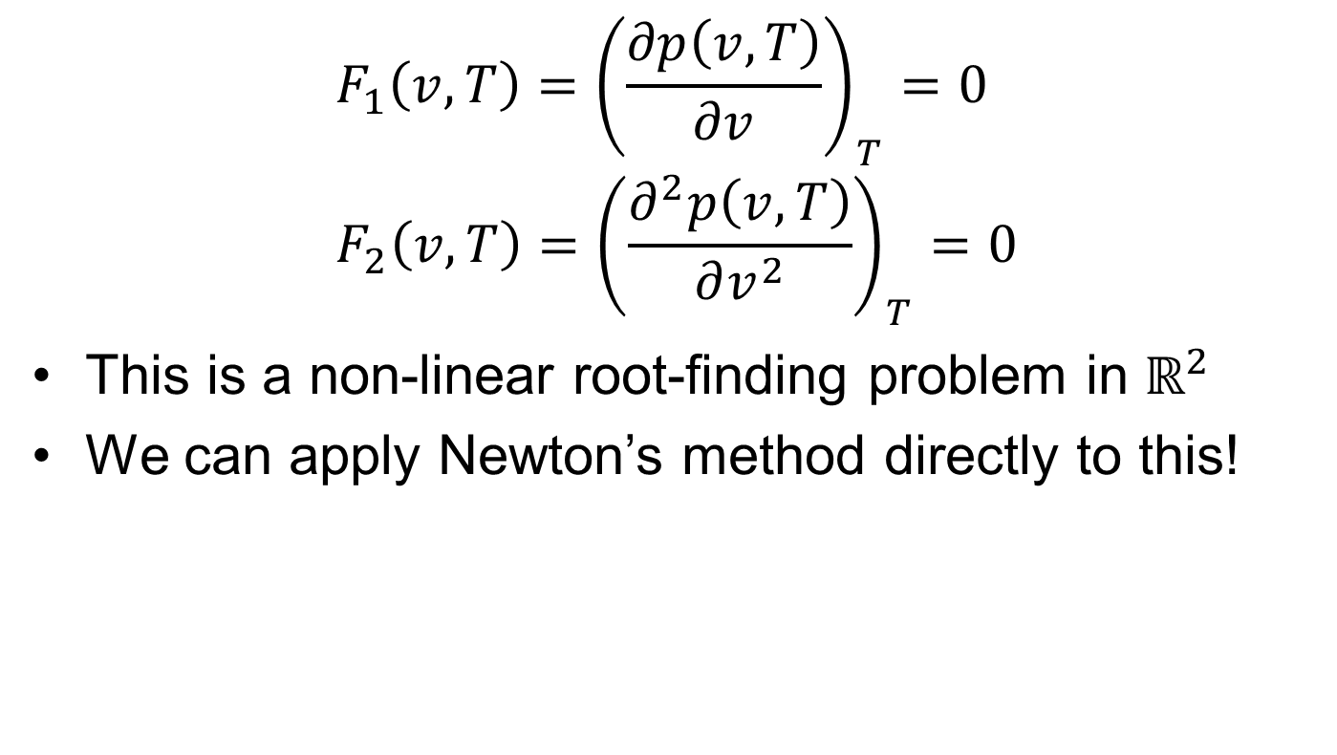
Critical point solver
$$F_{1}\left(v, T\right)={\left(\frac{∂p\left(v, T\right)}{∂v}\right)}_{T}=0 \\ {F_{2}\left(v, T\right)=\left(\frac{∂^{2}p\left(v, T\right)}{∂v^{2}}\right)}_{T}=0$$
This is a non-linear root-finding problem in $ℝ^{2}$
We can apply Newton’s method directly to this!

Slide 21
Critical point solver
Switch to notebook and show implementation
Notes:
# Solve system for critical point
res = nlsolve((F, x) -> critical_objective!(model, F, [exp10(x[1]), Ts*x[2]]), x0, autodiff = :forward, xtol=1e-9, method=:newton)

Slide 22
Key messages
Understand why specifying temperature is preferable in saturation calculations
Know that when building phase diagrams, it is crucial to reuse previous solutions as initial guesses for the next iteration
Know that critical points can be directly solved for using automatic differentiation

